Slide 1
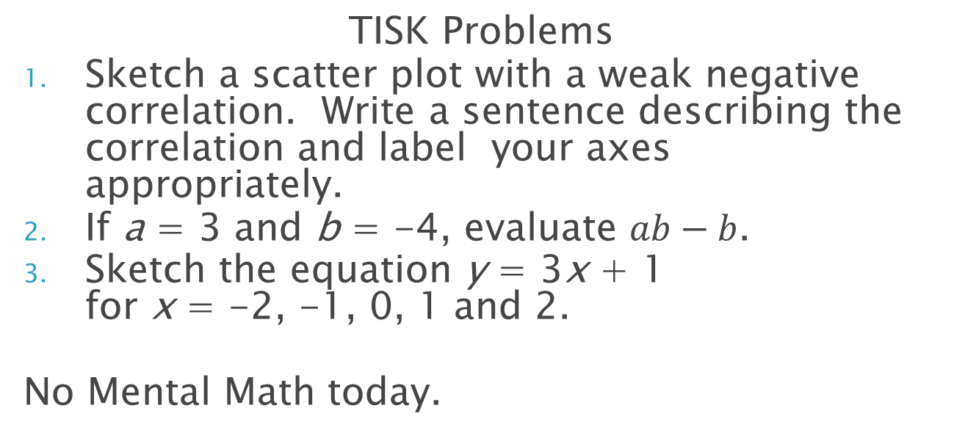
Monday, August 27, 2012
TISK Problems
Sketch a scatter plot with a weak negative correlation. Write a sentence describing the correlation and label your axes appropriately.
If a = 3 and b = -4, evaluate $ab−b$.
Sketch the equation y = 3x + 1 for x = -2, -1, 0, 1 and 2.
No Mental Math today.
Homework: p. 86 #12-17 & 22-25

Slide 2

Homework Check
30) -5.35
32) 9
34) -1288
36) 6.35
38) -24.27
40) $−\frac{1}{12}$
41) $\frac{1}{17}$
42) $\frac{25}{6}$
43) $−\frac{9}{4}$
57) 1
58) 24
59) -144
60) False
61) False
62) True
63) True
65) a. Juan deposited $100.
b. Juan withdrew $50.
c. Juan must make 8 $25 deposits to save $200.

Slide 3
Quiz Time
When finished with your quiz…
Organize your 4 homework assignments and quiz on your desk in the following order:
Quiz on top
2.4 Homework
2.3 Homework
2.2 Homework
2.1 Homework
Wait quietly until time is up.
Have your notes out and ready for the lesson when time is up.

Slide 4
§2.5 Properties of Algebra
Commutative Property of …
… Addition
For all real numbers a and b: a + b = b + a
So what does that mean?
… Multiplication
For all real numbers a and b: ab = ba
So what does that mean?

Slide 5
§2.5 Properties of Algebra
Associative Property of …
Addition
For all real numbers a, b, and c: (a + b) + c = a + (b + c)
Why is this helpful?
Multiplication
For all real numbers a, b, and c: (ab)c = a(bc)
How can this help us?

Slide 6
Example Problems
Complete each step and name the property used.
(36 + 15) + 64
= (15 + ? ) + 64 Commutative Property
= 15 + (36 + ? ) ____________ Property
= 15 + ? )
== ? _
36
64
Associative
100
115

Slide 7
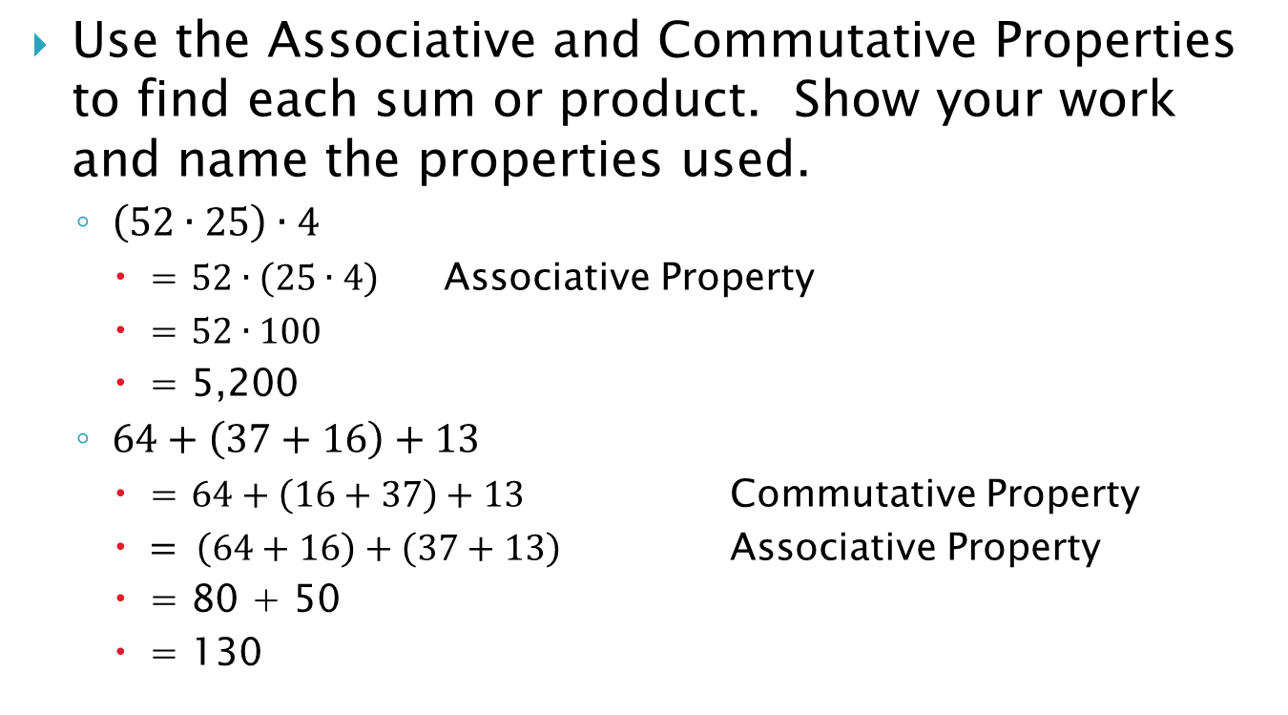
Example Problems
Use the Associative and Commutative Properties to find each sum or product. Show your work and name the properties used.
$\left(52∙25\right)∙4$
= $52∙\left(25∙4\right)$ Associative Property
= $52∙100$
= 5,200
$64+\left(37+16\right)+13$
= $64+\left(16+37\right)+13$ Commutative Property
$= \left(64+16\right)+\left(37+13\right)$ Associative Property
= 80 + 50
= 130

Slide 8
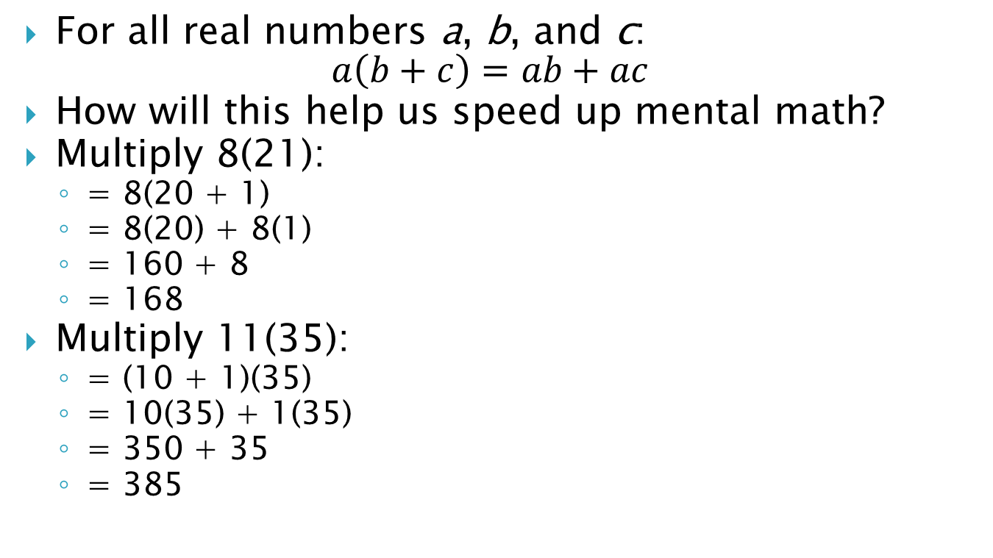
Distributive Property
For all real numbers a, b, and c: $a\left(b+c\right)=ab+ac$
How will this help us speed up mental math?
Multiply 8(21):
= 8(20 + 1)
= 8(20) + 8(1)
= 160 + 8
= 168
Multiply 11(35):
= (10 + 1)(35)
= 10(35) + 1(35)
= 350 + 35
= 385

Slide 9
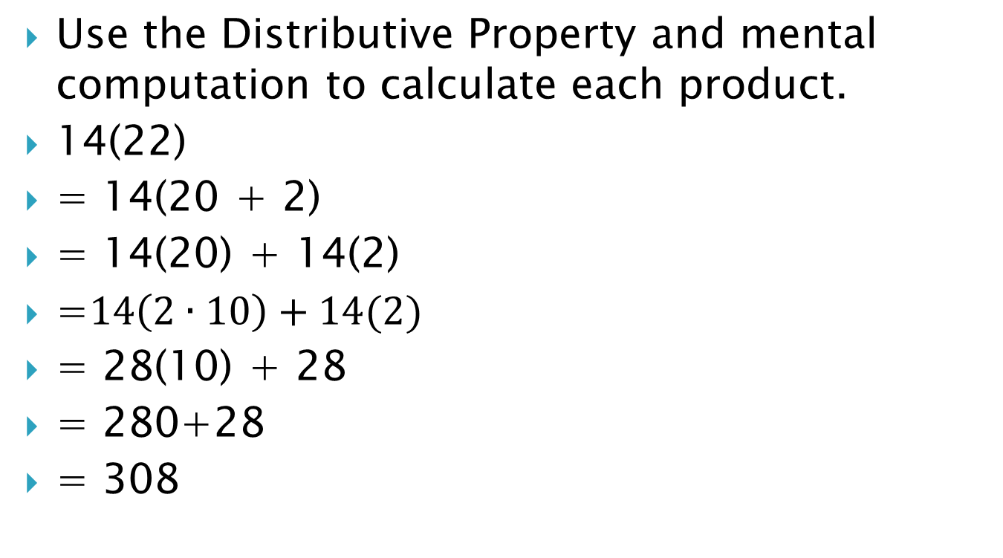
Example Problems
Use the Distributive Property and mental computation to calculate each product.
14(22)
= 14(20 + 2)
= 14(20) + 14(2)
=$14\left(2∙10\right)+14(2)$
= 28(10) + 28
= 280+28
= 308

Slide 10
Homework
p. 86 #12-17 & 22-25

